Slide 1
Recognizing Complements
English
Omed Hassan

Slide 2
Complements
Once you can recognize subjects and verbs, you can move on to next step in sentence analysis, recognizing complements.
A complement is a word that completes the meaning of the subject and the predicate.
The four most important complements are:
Direct Object
Indirect Object
Predicate Nominatives
Predicate Adjectives

Slide 3
Complements
Direct Object
Not all verbs take direct object.
The direct object receives the action of the verb.
When a verb has a direct object, the object generally appears in a sentence after the subject and the verb.
Just as you asked Who or What? before the verb to find the
subject, you ask Whom or What? after the verb to find the direct
object.
Who vs Whom
Who made this decision? [who is the subject of the sentence]
Whom do you think we should support? [whom is the object of support]

Slide 4
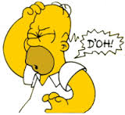
Direct object
Example:
John made a mistake.
To find the direct object, ask whom or what after the verb:
John made whom or what?
mistake is the direct object.

Slide 5
Direct object
The following chart indicates which questions to ask,
where to ask them, and which order to ask them in.
Mary made a mistake.
Subject (Who? Verb (Whom? Direct Object
What) What?)
Mary made mistake

Slide 6

Direct object
    Not all sentences have direct objects
    Example:
    John swims every day.
    John is the subject and swims is the verb
    There is no direct object

Slide 7
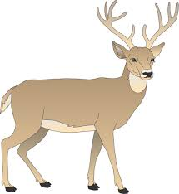
Direct object
Not all action verbs take direct objects.
Remember, that only the action verbs can take direct objects.
Note the following example:
The animal is a deer.
There cannot be a direct object since the verb is the linking verb
is and not an action verb.

Slide 8

Direct object
On the other hand:
1.This company produces ten cars an hour.
The verb produces is an action verb; it can and does take a direct object-cars.
The cars receive the action of being produced

Slide 9
Direct object
2.John likes Beth Henson very much.
Beth Henson receives the action of being liked.
In sentences 1 and 2 the receiver of the action is the direct object.
The direct object answer the question Whom or What? asked after the verb:

Slide 10
Direct object
This company produces What?
Cars is the direct object.
John likes whom?
Beth Henson is the direct object.

Slide 11

Direct object
Though the most common pattern for sentences containing direct objects is subject-verb-object, do not assume that is the only pattern.
Does John play golf often?
Notice does is an auxiliary, John is the subject, play is the main verb, and golf is the direct object.
The pattern is auxiliary- subject-verb-object.
aux. s. v d.o.
Do computers solve problems quickly?

Slide 12
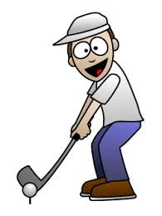
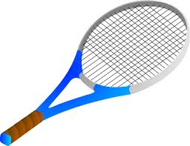
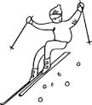
Direct object
Compound Objects
Like verbs and subjects, direct objects can be compound.
Example:
John likes golf, tennis, and skiing.
d.o. d.o. d.o.

Slide 13
A Checklist for Direct Objects
A direct object must:
1.Be a naming word.
2.Be in the predicate.
3.Follow an action verb.
4.Answer the questions: What? Or Whom?

Slide 14
Indirect Object
After learning to recognize subjects, verbs, and direct objects, the next sentence part you need to look for is the indirect object.
Like subjects and direct objects, indirect objects are naming words.
You can find an indirect object if it is present by asking To or for whom? or To or for what? After the direct object.

Slide 15
Indirect Object
s. v. d.o.
Bruce gave Martha a ring.
Bruce gave a ring to or for whom?
Martha is the indirect object.
s. v. d.o.
The philanthropist gave the museum a million dollars.
The philanthropist gave dollars to or for what? Museum is the indirect object.

Slide 16
Indirect Object
Most sentences will not contain indirect objects, because only a few verbs can take them.
give, bring, buy, present, throw, award
Even though the indirect object is the fourth sentence part you try to find, it is generally located in the sentence before the direct object.
The most natural order is
subject- verb- indirect object- direct object

Slide 17

Indirect Object
Note the following examples:
s. v. i.o. d.o.
The quarterback threw his receiver a perfect pass.
s. v. i.o. d.o.
The committee awarded Sara the prize.

Slide 18
Indirect Object
aux. s. v. i.o. d.o.
Did the executive buy her office a new typewriter?
But such a sentence fits the pattern of subject- verb- indirect object- direct object if you turn it around into a statement.
s. v. i.o. d.o.
The executive bought her office a new typewriter.

Slide 19
Indirect Object
One thing to remember when studying indirect objects is that you must mentally supply the words to or for before the whom or what.
If the sentence has the to or for expressed, the word cannot be an indirect object.
The quarterback threw a perfect pass to his receiver.
Since the to is expressed, the word receiver cannot be an indirect object.

Slide 20
A checklist for Indirect Objects
An indirect object must:
1.Be a naming word
2.Be in the predicate
3.Follow an action verb.
4.Answer the questions:
“To whom?”
“To what?”
“For whom
“For what”

Slide 21
Predicate Nominatives
Only action verbs can take direct and indirect objects.
However, linking verbs take complements. One such complement is the predicate nominative.
Predicate nominative is a naming word(noun or pronoun) that follows a linking verb and renames the subject.

Slide 22
Predicate Nominatives
Same value in both sides
p.n.
Mr Ahmed is my father.
my father is a naming word that follows the linking verb is and rename the subject Mr Ahmed .
my father is a predicate nominative.

Slide 23
Predicate Nominatives
p.n.
Jane Martinez is a psychologist.
psychologist is a naming word that follows the linking verb is and rename the subject Jane Martinez.
Psychologist is a predicate nominative.

Slide 24
A Checklist for Predicate Nominatives
A predicate nominative must:
1.Be a naming word.
2.Be in the predicate part of the sentence.
3.Follow a linking verb.
4.Mean the same or rename the subject.

Slide 25
Predicate Adjectives
A predicate adjective is a word(adjective)that usually follows a linking verb or describes (modifies) the subject.
p.a.
Jane is happy.
Happy is an adjective that follows the linking verb is and modifies the subject Jane.
Happy describes Jane.
Happy is a predicate adjective.

Slide 26
Predicate Adjectives
He sounded very ill on the telephone.
What is the subject in the above sentence?
What is the verb?
What is "ill" in this sentence?
predicate adjective, predicate nominative, direct object, or indirect object?

Slide 27
A checklist for Predicate Adjectives
A predicate adjectives must:
1.Be an adjective.
2.Be in the predicate part of the sentence.
3.Follow a linking verb.
4.Modify the subject.

